Slide 1
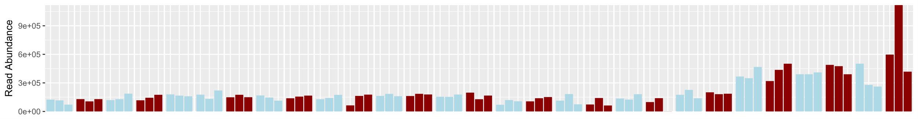
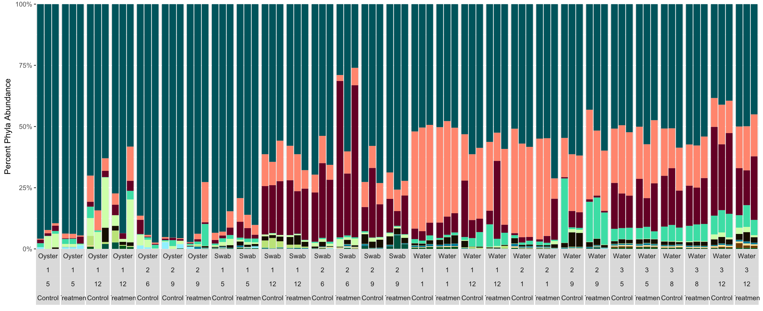
5 |  | 12 |  | 6 |  | 9 |  | 5 |  | 12 |  | 6 |  | 9 |  | 1 |  | 12 |  | 1 |  | 9 |  | 5 |  | 8 |  | 12 |  | Day
1 |  |  |  | 2 |  |  |  | 1 |  |  |  | 2 |  |  |  | 1 |  |  |  | 2 |  |  |  | 3 |  |  |  |  |  | Trial
Oyster Larvae |  |  |  |  |  |  |  | Biofilm Swab |  |  |  |  |  |  |  | Rearing Water |  |  |  |  |  |  |  |  |  |  |  |  |  | Type
9x10⁵
6x10⁵
3x10⁵
0
Group
Read Abundance
Control
Treatment
Phylum
75%
50%
25%
0%
Proteobacteria
Bacteroidetes
Cyanobacteria
Actinobacteria
Firmicutes
Planctomycetes
Chlamydiae
Unknown
Verrucomicrobia
Fusobacteria
Spirochaetae
Lentispaerae
Others
Percent Phyla Abundance
Notes:
1344x500
1344x175

Slide 2
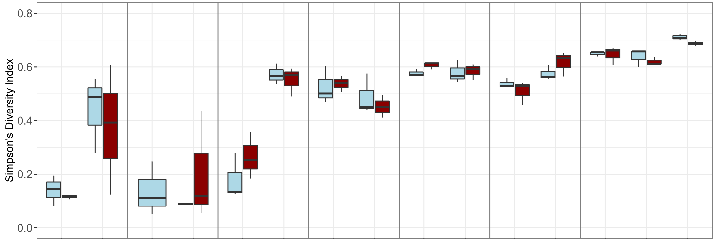
5 |  | 12 |  | 6 |  | 9 |  | 5 |  | 12 |  | 6 |  | 9 |  | 1 |  | 12 |  | 1 |  | 9 |  | 5 |  | 8 |  | 12 |  | Day
1 |  |  |  | 2 |  |  |  | 1 |  |  |  | 2 |  |  |  | 1 |  |  |  | 2 |  |  |  | 3 |  |  |  |  |  | Trial
Oyster Larvae |  |  |  |  |  |  |  | Biofilm Swab |  |  |  |  |  |  |  | Rearing Water |  |  |  |  |  |  |  |  |  |  |  |  |  | Type
**
*
**
**
**
Group
Control
Treatment
***
Significance
* p<0.05
** p<0.01
*** p<0.001
Simpson’s Diversity Index
***
Notes:
1200x500

Slide 3
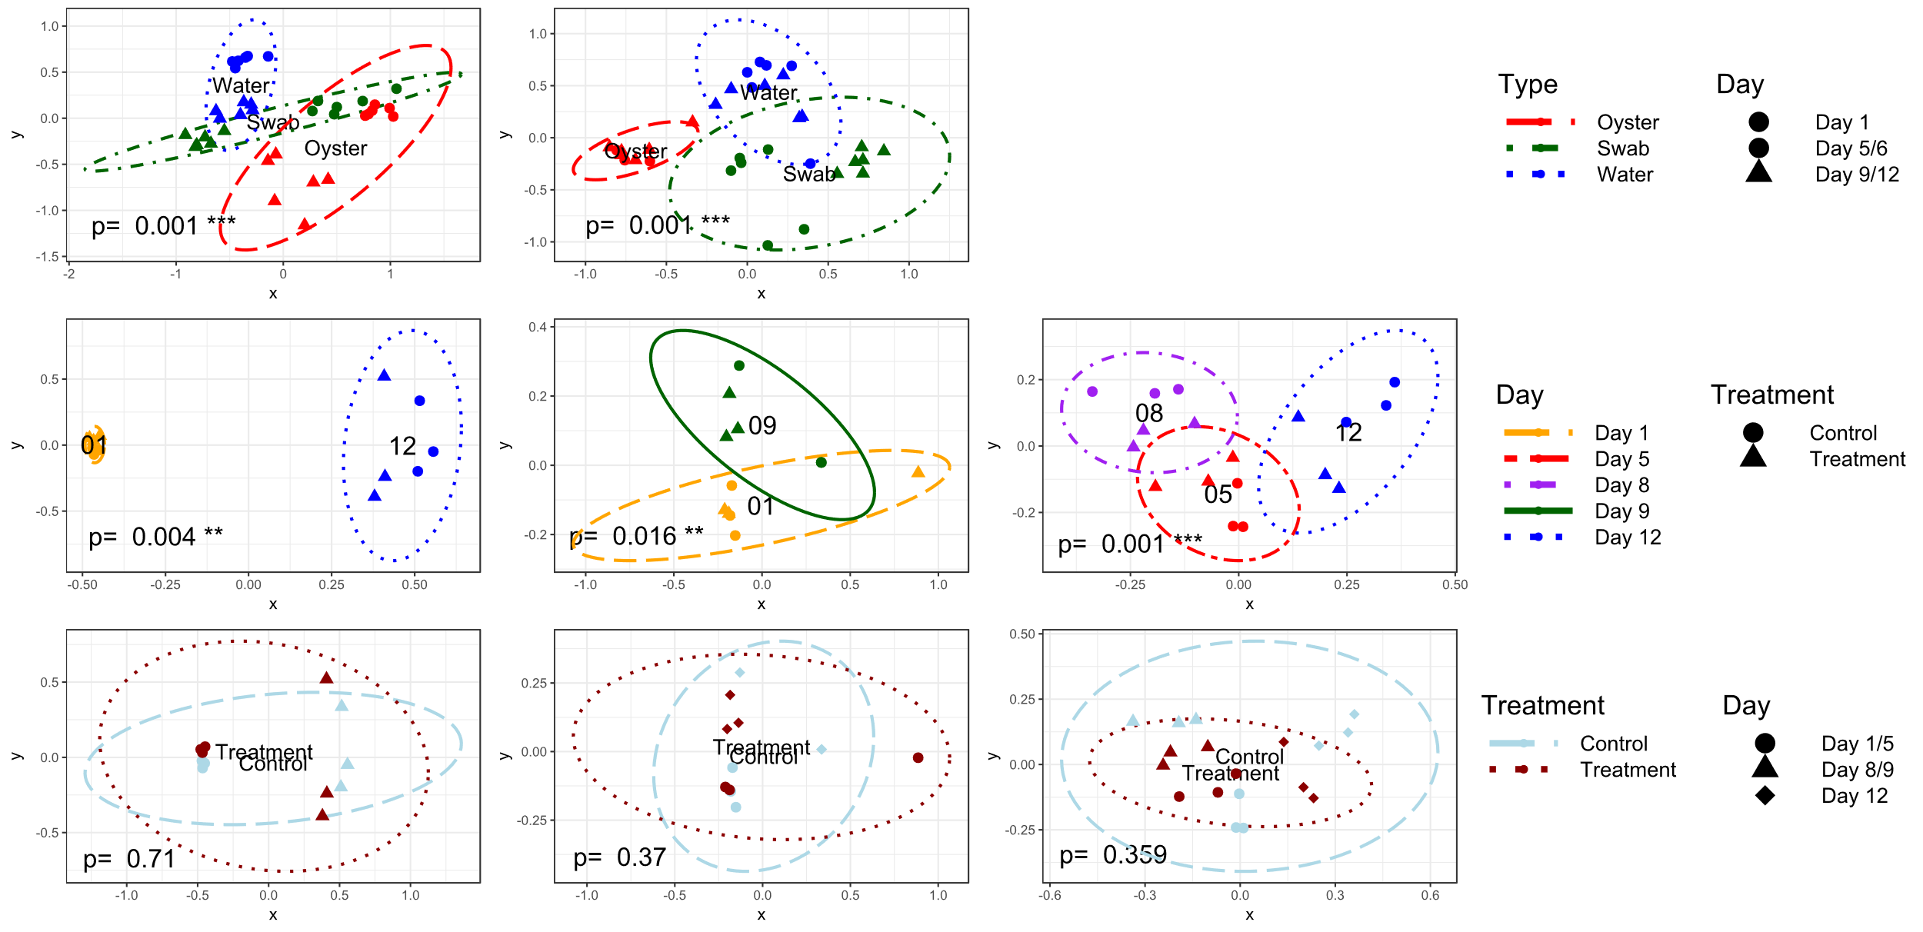
Trial 1
Trial 2
Trial 3
(A)
Sample Type
(B)
Day
(C)
Treatment Group
Notes:
1700x825

Slide 4
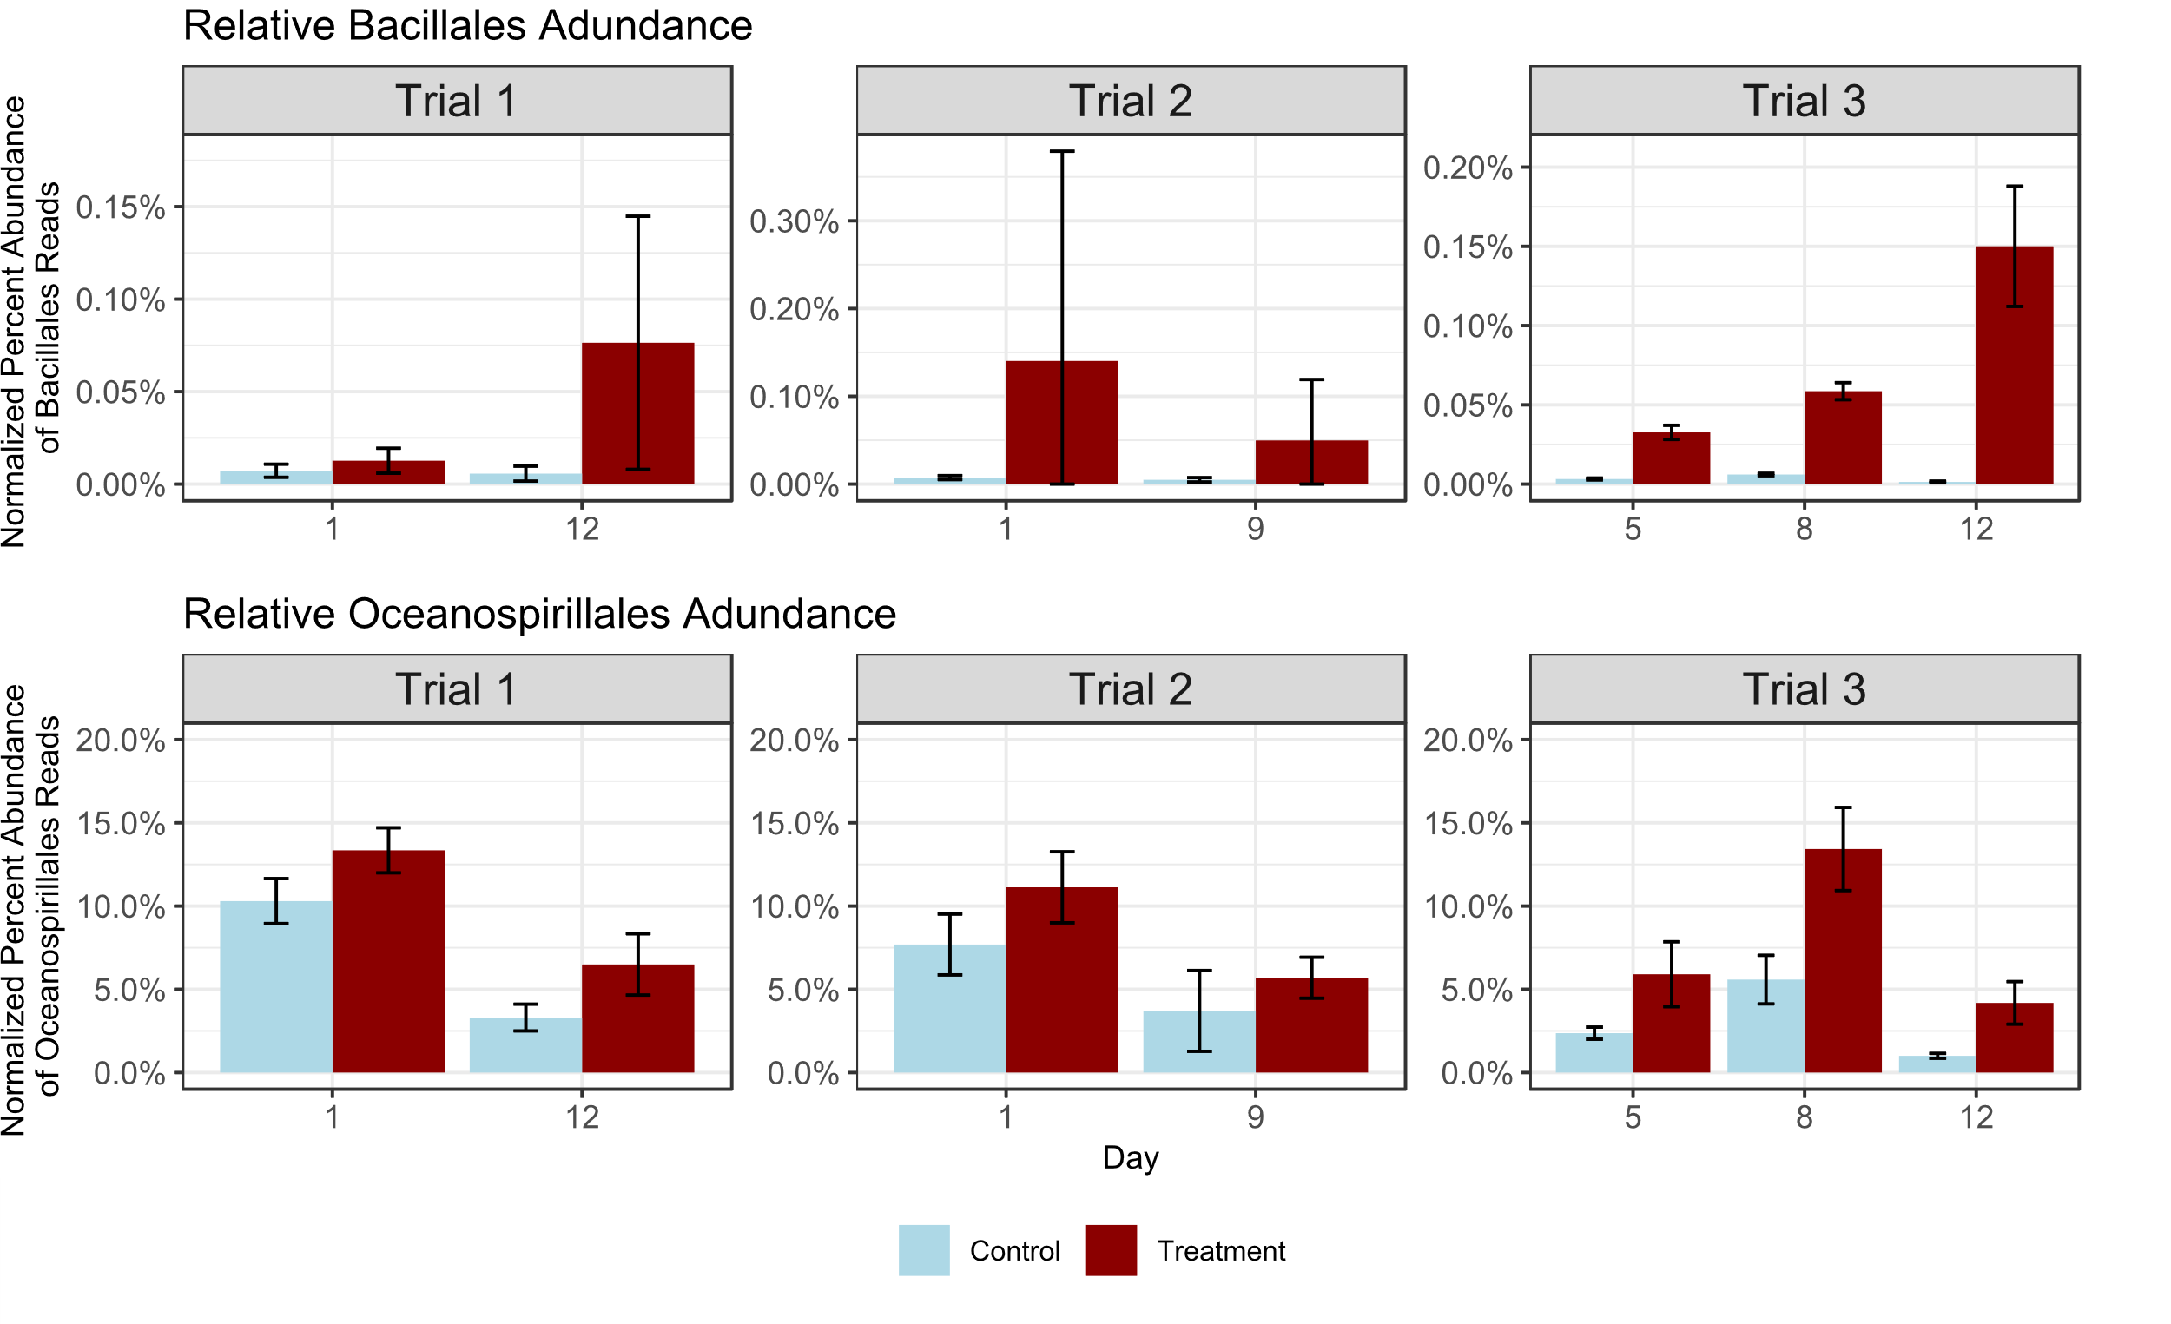
Control
Treatment
*
*
(A)
*
*
*
*
*
**
*
*
*
*
*
*
(B)
*
*
*
Notes:
900x550

Slide 5
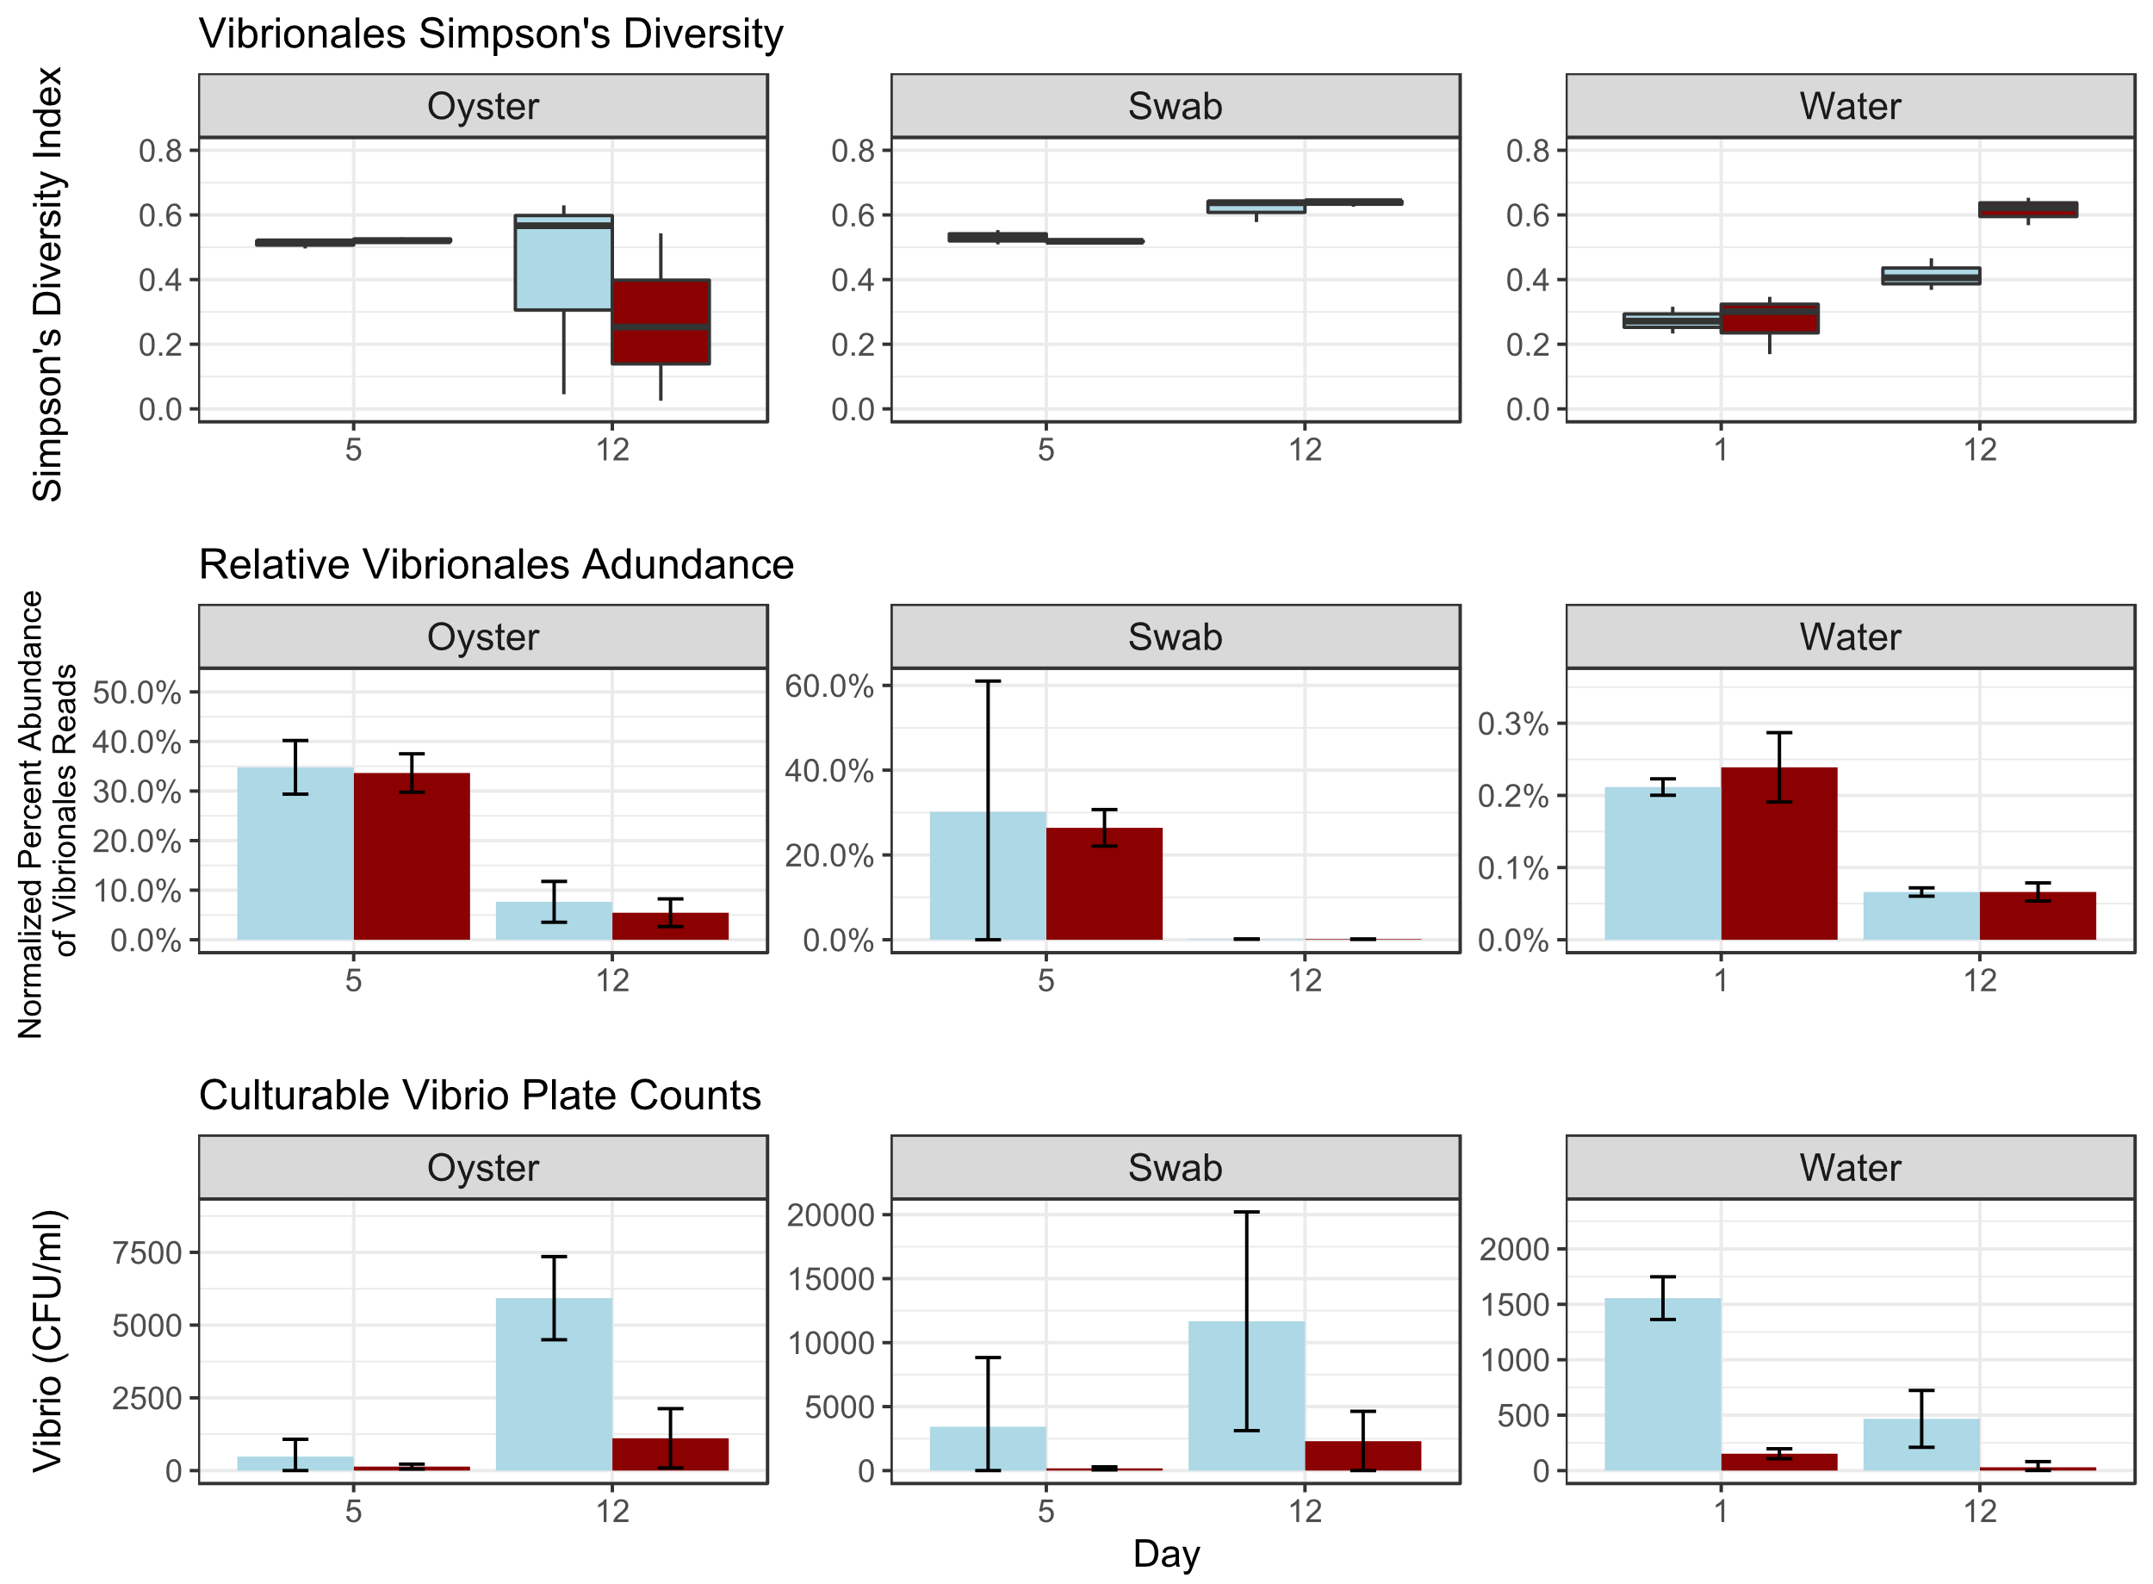
**
**
*
(A)
Control
Treatment
(B)
**
**
**
(C)
*
*
Notes:
900x700

Slide 6
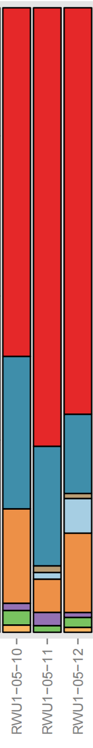
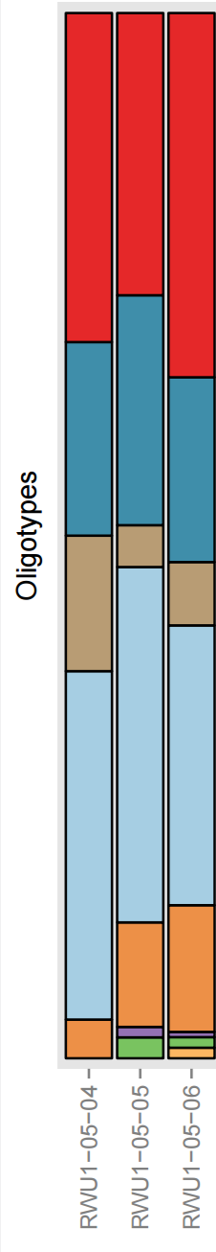
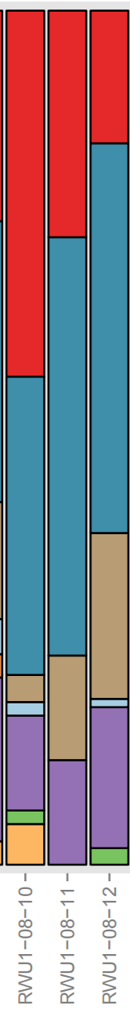
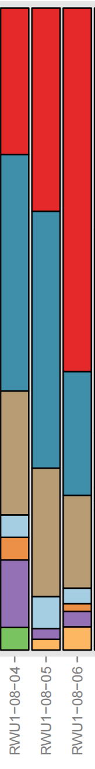
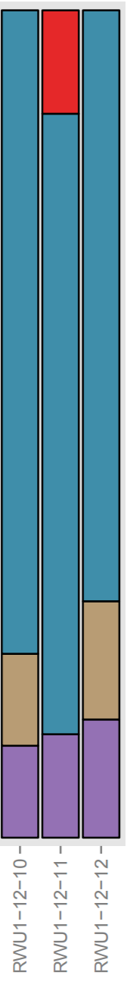
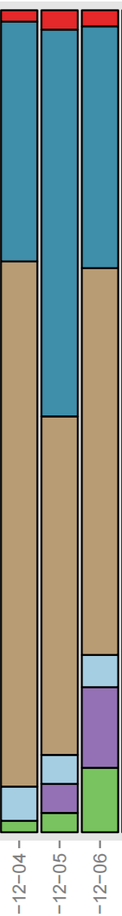
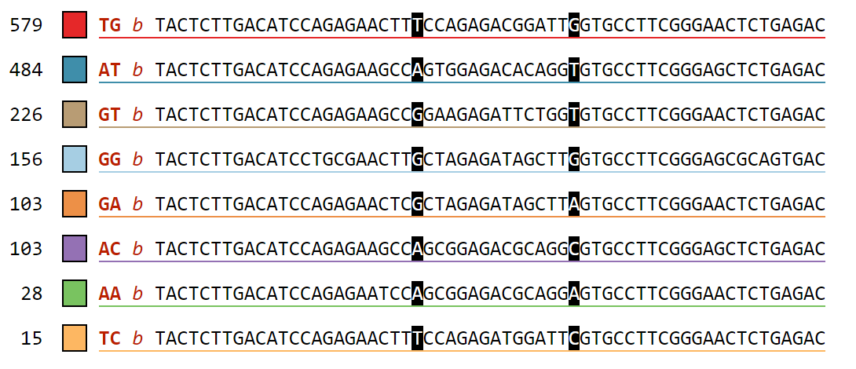

100%
CON | T | CON | T | CON | T
Day 5 |  | Day 8 |  | Day 12
Oligotypes
75%
Number of Sequences
Percent Abundance of Oligotypes
50%
25%
TG: Vibrio alginolyticus strain WW1; GenBank: KX425011.1
AT: Vibrio celticus, isolate 5OM18; GenBank: LN832936.1
GT: Vibrio orientalis, isolate LK2HaP4; GenBank: LT221239.1
GG: Halovibrio sp. strain 5F5; GenBank: KY636397.1
0%

Slide 7
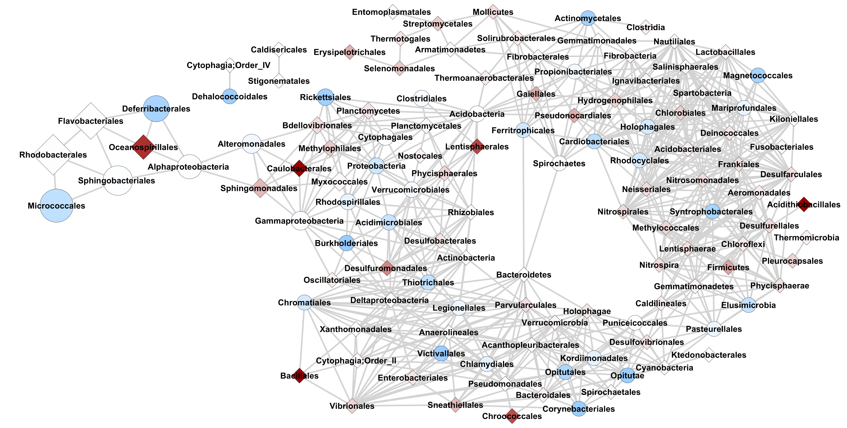

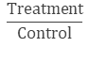
Occurrence
Number of Reads
3.6
1
0
2,700,000
1,350,000
675,000
2
$$\frac{Treatment}{Control}$$

